Slide 1
M- Commerce

Slide 2
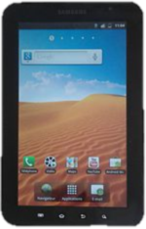
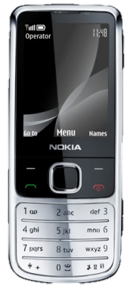
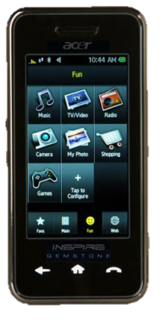
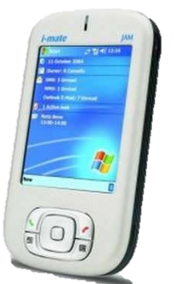

Slide 3
Services
Information based service
Location Based Service
Transaction Service
News
Stock Quote
Sports score
Financial Record
Traffic reporting
Local discount offers
Local weather
Tracking and monitoring of people
Mobile Money Transfer
Mobile ticketing
Content purchase and delivery

Slide 4
Brief History
1895
Marconi successfully transmitted radio waves without using wires
1940s
two-way car radios were installed by police, government agencies, and utility companies
1969
introduction of a commercial cellular radio operation on trains running from New York City to Washington, D.C.
introduction of analog-based cellular telephone services to the general public
1978

Slide 5
Brief History (cont.)
1G: 1979-1992
- operates in the 800-900 MHz frequency spectrum
- 832 frequencies available for transmission
- Lock the channel for the caller and the recipient through the telephone company’s switch
2G: early 1990s
- Operates between 9.6 Kbps and 14.4 Kbps in the 800 MHz and 1.9 GHz frequencies
2.5G: 2000
- “always on” capability
- Digital, not analog transmission
- Lacks a universal system of wireless communication and lack of the bandwidth inherent in a circuit-switched network
- Packet-switched design
- EDGE

Slide 6
Brief History (cont.)
3G: 2001-2005
- Streaming video
4G/LTE: 2006-2010
- Ultra high speed internet
- faster multimedia streaming
- Two-way voice over IP
- Internet traffic with high quality graphics for a wireless phone
- Transmission speeds of 2mbps for mobile wireless devices

Slide 7
What is M-Commerce
Transactions and payments conducted in a non-PC-based environment
The management of the processes that handle the product or service needs of a consumer via a mobile phone
Use of wireless devices to facilitate the sale of products and services, anytime, anywhere
any e-commerce done in a wireless environment, especially via the Internet

Slide 8
Mobile commerce from the Customer‘s point of view
The customer wants to access information, goods and services any time and in any place on his mobile device.
He can use his mobile device to purchase tickets for events or public transport, pay for parking, download content and even order books and CDs.
He should be offered appropriate payment methods. They can range from secure mobile micropayment(payment of very small amount of money usually $12-$20) to service subscriptions.

Slide 9
Mobile commerce from the Provider‘s point of view
The future development of the mobile telecommunication sector is heading more and more towards value-added services. Analysts forecast that soon half of mobile operators‘ revenue will be earned through mobile commerce.
Consequently operators as well as third party providers will focus on value-added-services. To enable mobile services, providers with expertise on different sectors will have to cooperate.
Innovative service scenarios will be needed that meet the customer‘s expectations and business models that satisfy all partners involved.

Slide 10
Terminology and Standards
GPS: Satellite-based Global Positioning System
PDA: Personal Digital Assistant—handheld wireless computer
SMS: Short Message Service
EMS: Enhanced Messaging Service
MMS: Multimedia Messaging Service
WAP: Wireless Application Protocol
Smartphones—Internet-enabled cell phones with attached applications

Slide 11
Attributes of M-Commerce and Its Economic Advantages
Mobility—users carry cell phones or other mobile devices
Broad reach—people can be reached at any time
Ubiquity—easier information access in real-time
Convenience—devices that store data and have Internet, intranet, extranet connections
Instant connectivity—easy and quick connection to Internet, intranets, other mobile devices, databases
Personalization—preparation of information for individual consumers
Localization of products and services—knowing where the user is located at any given time and match service to them

Slide 12
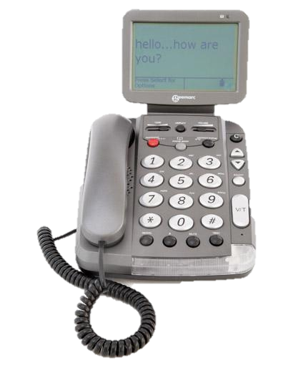
Mobile Computing Infrastructure
Hardware
Cellular (mobile) phones
PDAs
Interactive pagers
Other devices
Notebooks
Handhelds
Smartpads
Screenphones—a telephone equipped with color screen, keyboard, e-mail, and Internet capabilities
E-mail handhelds
Wirelined—connected by wires to a network

Slide 13
Mobile Computing Infrastructure (cont.)
Unseen infrastructure requirements
Suitably configured wireline or wireless WAN modem
Web server with wireless support
Application or database server
Large enterprise application server
GPS locator used to determine the location of mobile computing device carrier

Slide 14
Mobile Computing Infrastructure (cont.)
Software
Microbrowser
Mobile client operating system (OS)
Bluetooth—a chip technology and WPAN standard that enables voice and data communications between wireless devices over short-range radio frequency (RF)
Mobile application user interface
Back-end legacy application software
Application middleware
Wireless middleware

Slide 15
Mobile Computing Infrastructure (cont.)
Networks and access
Wireless transmission media
Microwave
Satellites
Radio
Infrared
Cellular radio technology
Wireless systems

Slide 16
Mobile Service Scenarios
Financial Services.
Entertainment.
Shopping.
Information Services.
Payment.
Advertising.
Location based services
And more ...

Slide 17
Early content and applications have all been geared around information delivery but as time moves on the accent will be on revenue generation.
Entertainment
Music
Games
Graphics
Video
Pornography
Communications
Short Messaging
Multimedia Messaging
Unified Messaging
e-mail
Chatrooms
Video - conferencing
M- commerce
Transactions
Banking
Broking
Shopping
Auctions
Betting
Booking & reservations
Mobile wallet
Mobile purse
Information
News
City guides
Directory Services
Maps
Traffic and weather
Corporate information
Market data

Slide 18
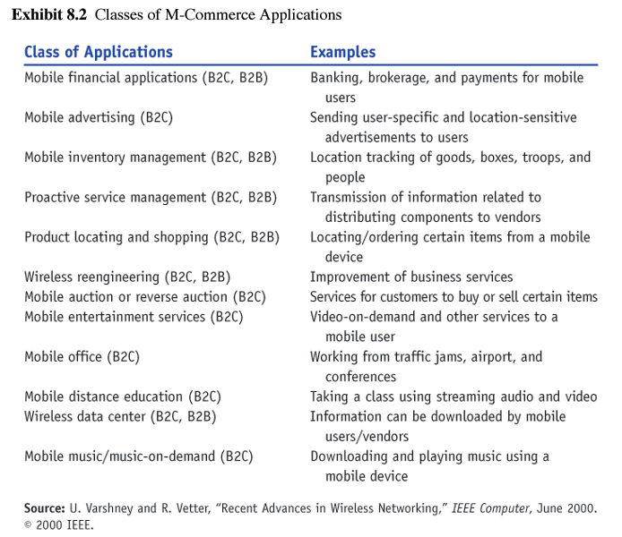
Classes of M-Commerce Applications

Slide 19
Mobile Application: Financial Tool
As mobile devices become more secure
Mobile banking
Bill payment services
M-brokerage services
Mobile money transfers
Mobile micropayments
Replace ATM’s and credit cards??

Slide 20
Financial Tool: Wireless Electronic Payment Systems
“transform mobile phones into secure, self-contained purchasing tools capable of instantly authorizing payments…”
Types:
Micropayments
Wireless wallets (m-wallet)
Bill payments

Slide 21
Examples
Swedish Postal Bank
Check Balances/Make Payments & Conduct some transactions
Dagens Industri
Receive Financial Data and Trade on Stockholm Exchange
Citibank
Access balances, pay bills & transfer funds using SMS

Slide 22
Mobile Applications : Marketing, Advertising, And Customer Service
Shopping from Wireless Devices
Have access to services similar to those of wireline shoppers
Shopping carts
Price comparisons
Order status
Future
Will be able to view and purchase products using handheld mobile devices

Slide 23
Mobile Applications : Marketing, Advertising, And Customer Service
Targeted Advertising
Using demographic information can personalize wireless services (barnesandnoble.com)
Knowing users’ preferences and surfing habits marketers can send:
User-specific advertising messages
Location-specific advertising messages

Slide 24
Mobile Applications : Marketing, Advertising, And Customer Service
CRM applications
MobileCRM
Comparison shopping using Internet capable phones
Voice Portals
Enhanced customer service improved access to data for employees

Slide 25
Mobile Portals
“A customer interaction channel that aggregates content and services for mobile users.”
Charge per time for service or subscription based
Example: I-Mode in Japan
Mobile corporate portal
Serves corporations customers and suppliers

Slide 26
Mobile B2B and Supply Chain Applications
“mobile computing solutions enable organizations to respond faster to supply chain disruptions by proactively adjusting plans or shifting resources related to critical supply chain events as they occur.”
accurate and timely information
opportunity to collaborate along supply chain
must integrate mobile devices into information exchanges
example: “telemetry” integration of wireless communications, vehicle monitoring systems, and vehicle location devices
leads to reduced overhead and faster service responsiveness (vending machines)

Slide 27
Applications of Mobile Devices for Consumers/Industries
Personal Service Applications
example airport
Mobile Gaming and Gambling
Mobile Entertainment
music and video
Hotels
Intelligent Homes and Appliances
Wireless Telemedicine
Other Services for Consumers

Slide 28
Mobile Payment for M-Commerce
Mobile Payment can be offered as a stand-alone service.
Mobile Payment could also be an important enabling service for other m-commerce services (e.g. mobile ticketing, shopping, gambling…) :
It could improve user acceptance by making the services more secure and user-friendly.
In many cases offering mobile payment methods is the only chance the service providers have to gain revenue from an m-commerce service.

Slide 29
Mobile Payment (cont.)
the consumer must be informed of:
what is being bought, and
how much to pay
options to pay;
the payment must be made
payments must be traceable.

Slide 30
Mobile Payment (cont.)
Customer requirements:
a larger selection of merchants with whom they can trade
a more consistent payment interface when making the purchase with multiple payment schemes, like:
Credit Card payment
Bank Account/Debit Card Payment
Merchant benefits:
brands to offer a wider variety of payment
Easy-to-use payment interface development
Bank and financial institution benefits
to offer a consistent payment interface to consumer and merchants

Slide 31


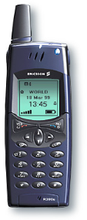


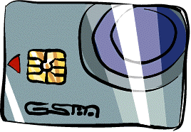
Payment via Internet Payment Provider
WAP GW/Proxy
Browsing (negotiation)
Merchant
MeP
GSM Security
SSL tunnel
User
SMS-C
IPP
Mobile Wallet
CC/Bank

Slide 32
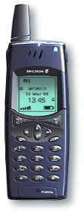

Payment via integrated Payment Server
WAP GW/Proxy
Browsing (negotiation)
Mobile Commerce
Server
Merchant
GSM Security
User
SSL tunnel
SMS-C
ISO8583 Based
CP
VPP IF
CC/Bank
Mobile Wallet
Voice PrePaid

Slide 33
Limitations
Small keypad and without a mouse
Devices have limited memory
Reliability uncertain
A period of high latency or delays before making the connections
Quality of service varies
Difficult for the user to remember all the phone numbers, keywords, or codes
Security issues
Legal Issues

